Slide 1
RL بالعربي
L05 - Deep Q-Networks

Slide 2
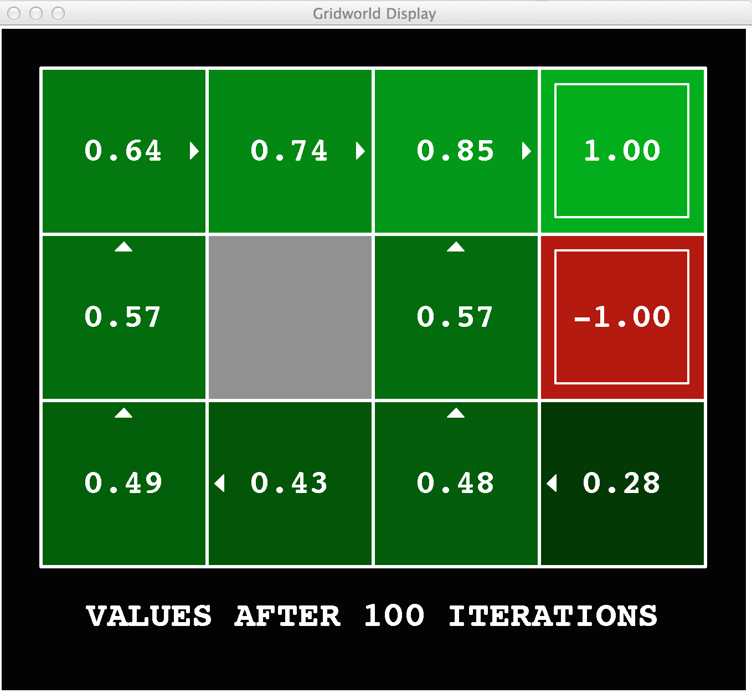
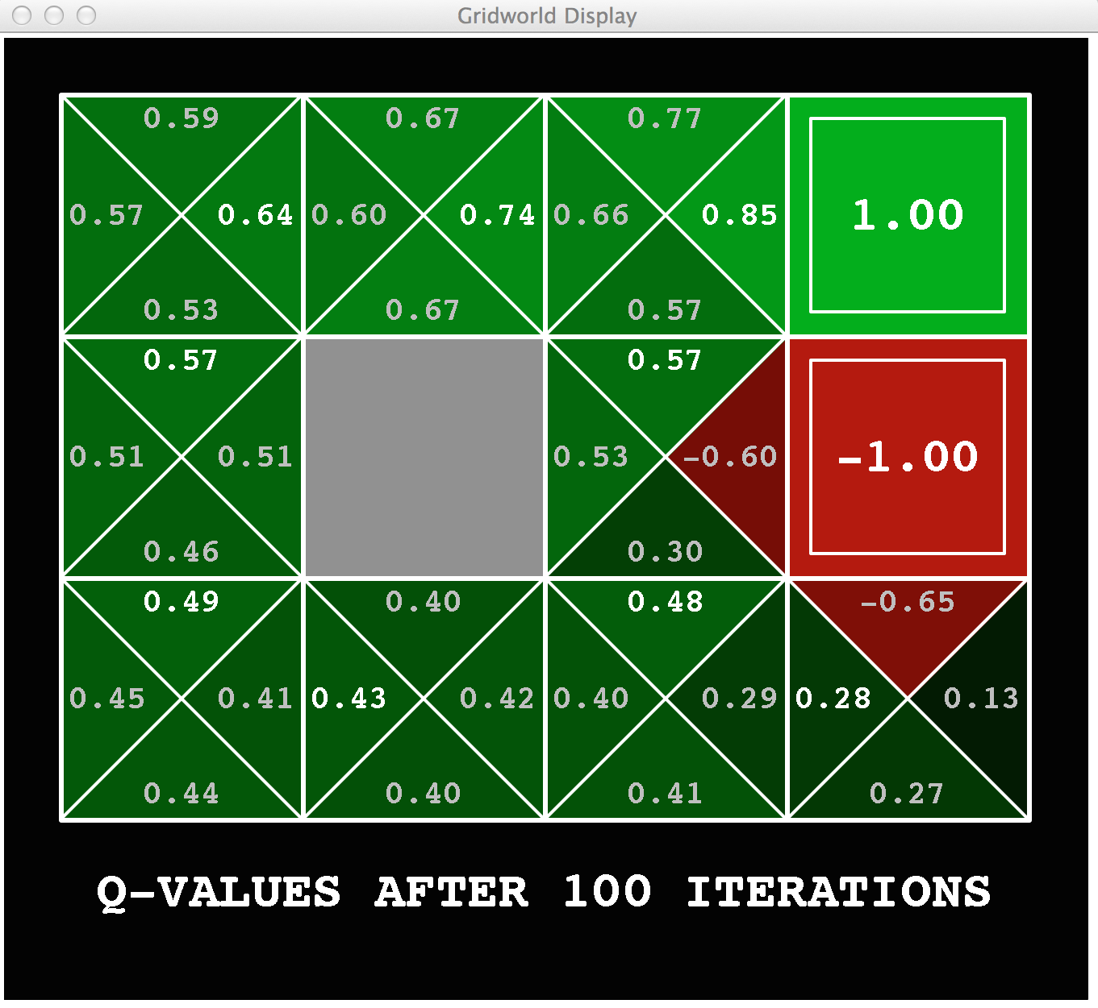
Recap
V(s) vs. Q(s,a)
MDPs (Offline learning) vs RL (Online learning)
Q-Learning Algorithm Q(s,a) ← (1 - α) Q(s,a) + α [r + 𝛾 max_{a’} Q(s’,a’)]

Slide 3
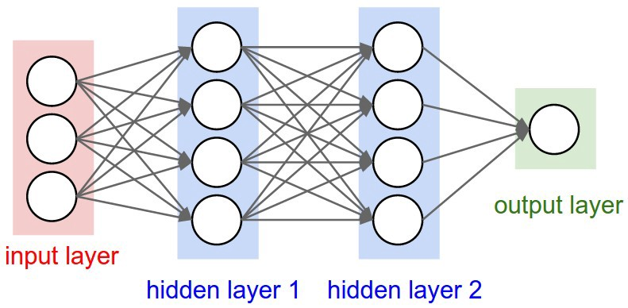
Refresher: Deep Learning

Slide 4
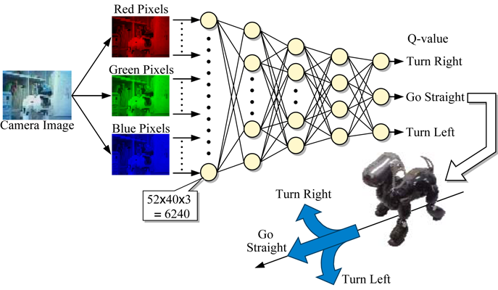
Deep Q-Networks
Input: current state (s)
Variable: Network parameters (w)
Output: Q-values for all actions Q(s,a,w) ≈ Q*(s,a)

Slide 5
Using Bellman equations
We know that Q(s,a) ← r + 𝛾 max_{a’} Q(s’,a’)
Including the network weights (w) into the equation Q(s,a,w) ← r + 𝛾 max_{a’} Q(s’,a’,w)
But we have both sides of this equation!
Q(s,a,w) : current estimate of Q value (from the network).
r + 𝛾 max_{a’} Q(s’,a’,w) : can be calculated from the environment

Slide 6
Loss function
So what we need to ensure is that L.H.S. = R.H.S. In other words ensure that bellman equation is satisfied. This means that the loss function is MSE of L.H.S and R.H.S L = ( r + 𝛾 max_{a’} Q(s’,a’,w) - Q(s,a,w) )²
Should Q* converge now?

Slide 7
Problem?
Using only previous setup will not help Q* to converge easily because of two reasons:
Samples correlation: samples that occur consecutively are mostly very same which doesn’t add any diversity to the model
Non-stationary targets: targets already change as the policy improves (better rewards so better Q-values)
Experience Replay is a technique used to solve these problems.

Slide 8
Experience Replay
Run the environment with the fixed weights (w⁻) of the network.
Store the history in a memory (Queue)
Sample from this experiences to continue network training.

Slide 9
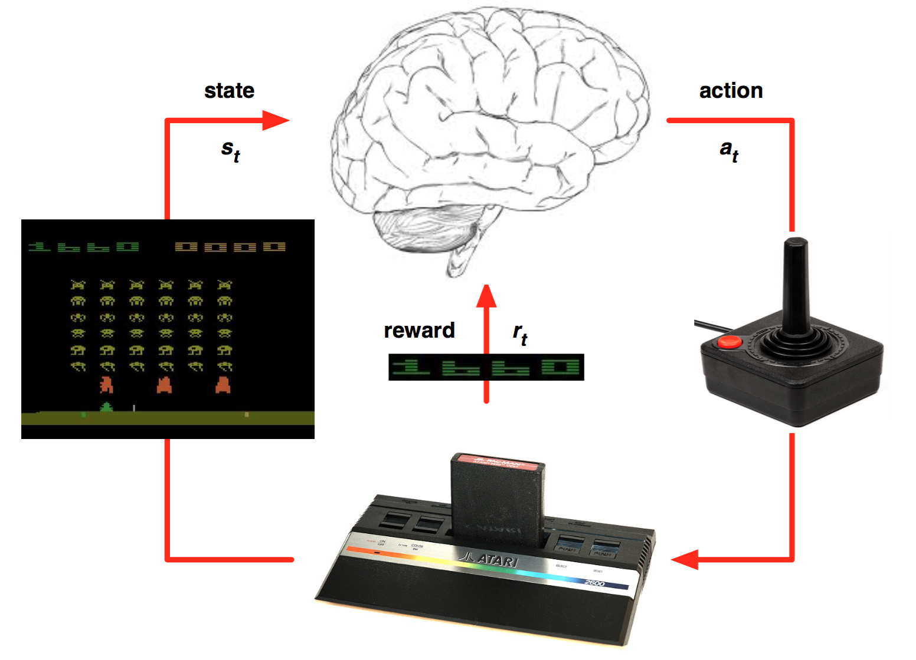
DQNs with Atari

Slide 10
Next Lesson: Demo
We will write a DQN Agent to play pong

Slide 11
References
Deep Reinforcement Learning Tutorial - David Silver, Google DeepMind
https://pdfs.semanticscholar.org/presentation/5a15/b1b8bb00c69cb534310ef769b0297ca9c95a.pdf
Playing Atari with Deep Reinforcement Learning

